Slide 1
MakeItAwesome: Doon
SA Presentation

Slide 2
Introduction
Introduction:
Group Members:
Amara (TL4)
Items
Andreas(TL2)
HUD
Game Manager
Caden (TL5)
Enemies
Elizabeth (TL6)
Controls
Protagonists
Joe (TL3)
Audio Manager
Menus

Slide 3
Doon
Goal:
Create a game which allows users to experience the Dune universe.
Emphasis on story telling but within the medium of a platformer game.
Story: Based on Dune
Story/Adventure style platformer game.
Multiple possible endings.
More to come in the story board slides.

Slide 4
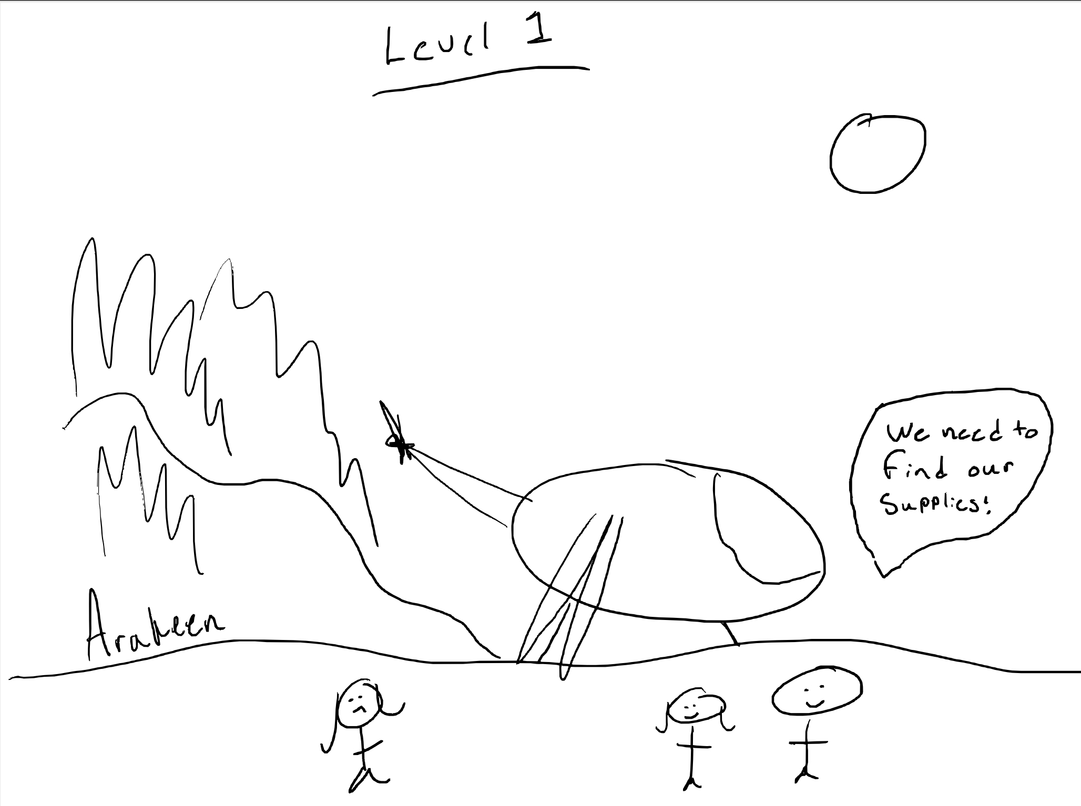
Storyboard: 1
Doon opens with the Paul being dropped in the desert with his mom. They are alone after his dad and house were killed by the Harkonens and Feyd Rautha. He must now survive and bring Feyd Rautha justice for his family.
If he does care he can run off with Chani, a total stranger who looks like Zendaya, and fall in love. The end.

Slide 5
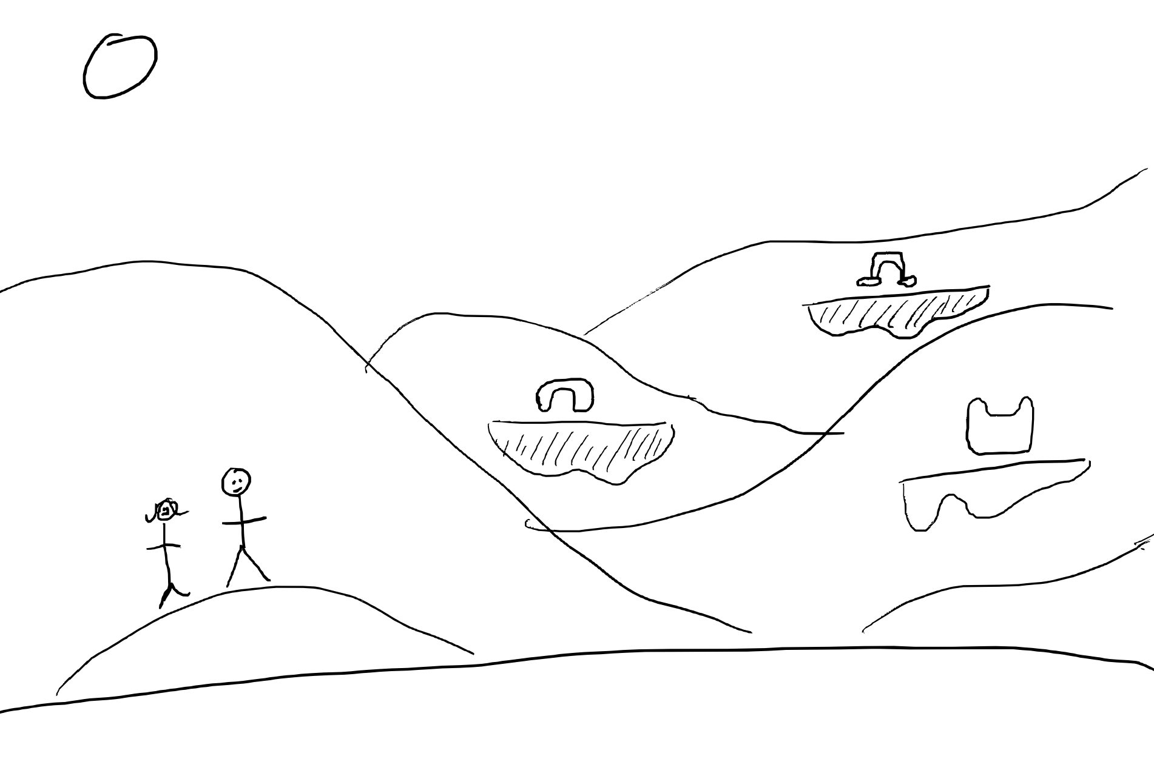
Storyboard: 2
Paul starts level 1 when his mother comes into the scene and tells the Paul they need to find four items: a knife, tent, hook, and stil suit. She tells him to watch out for Harkonens and find the water of Shai Hulud so that he can have strength for the journey ahead.

Slide 6
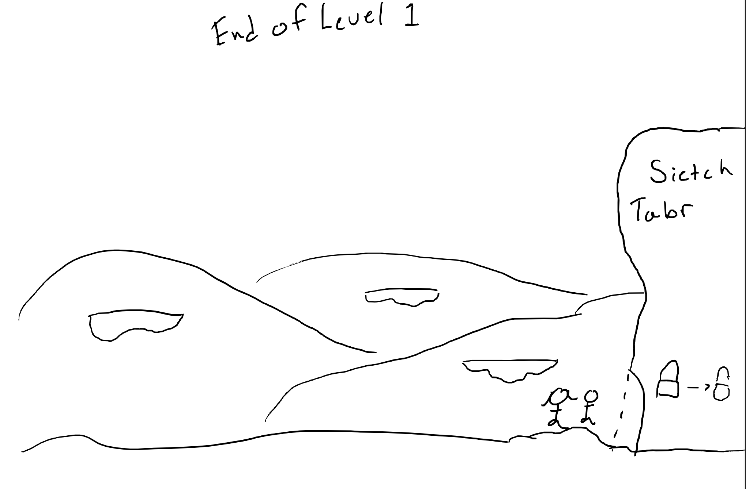
Storyboard: 3
Once the Paul finds all the items and makes his way to Sietch Tabr (Doon village), he can enter and end the first level. Within Sietch Tabr, Paul can begin Level 2.
If they reach Sietch Tabr before collecting all the items, a dialogue box pops up telling them they are not ready to enter.

Slide 7
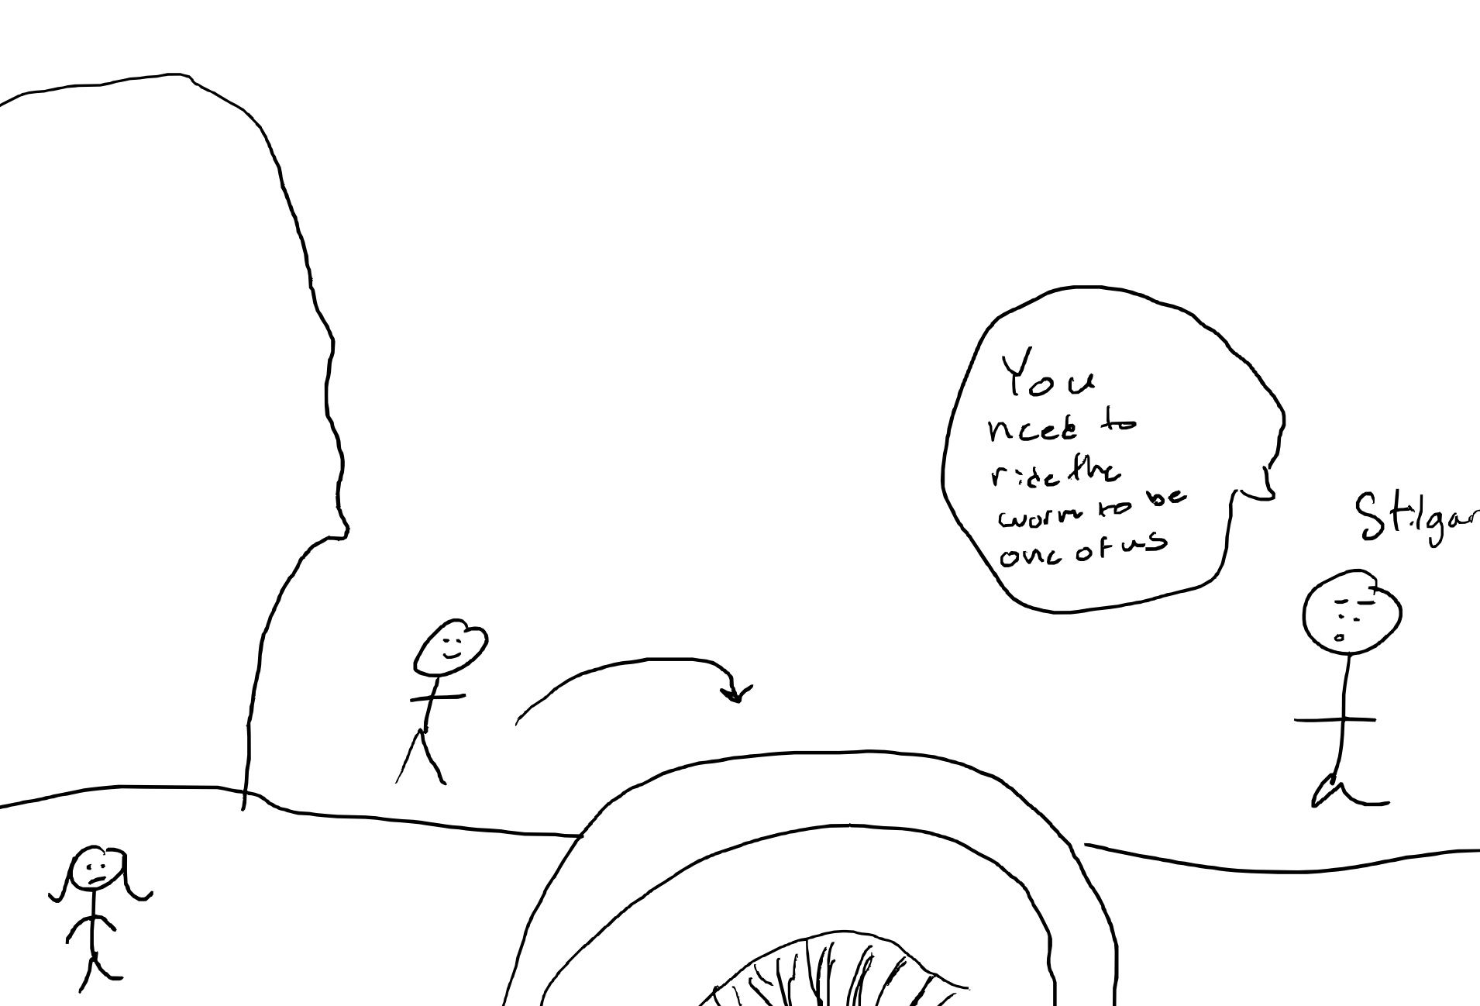
Storyboard: 4
In the opening scene of Level 2, Paul is approached by Stilgar. He asks if Paul is ready to ride the worm. Paul then moves over and hops on top of the worm and sets off to find and fight Feyd-Rautha.
If he chooses not to ride the worm, he can return to Sietch Tabrand finish off his days, in love, with Chani. The end.

Slide 8
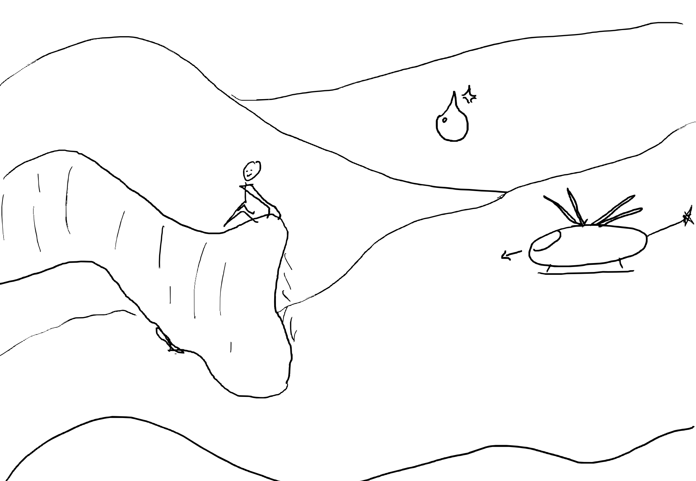
Storyboard: 5
After Paul successfully mounts the Shai Hulud, he now needs to ride all the way to the emperor's palace to fight Feyd Rautha. Paul will need to avoid ornithopters, and get water for adventures ahead. He can't lose too much health, or he will die.

Slide 9
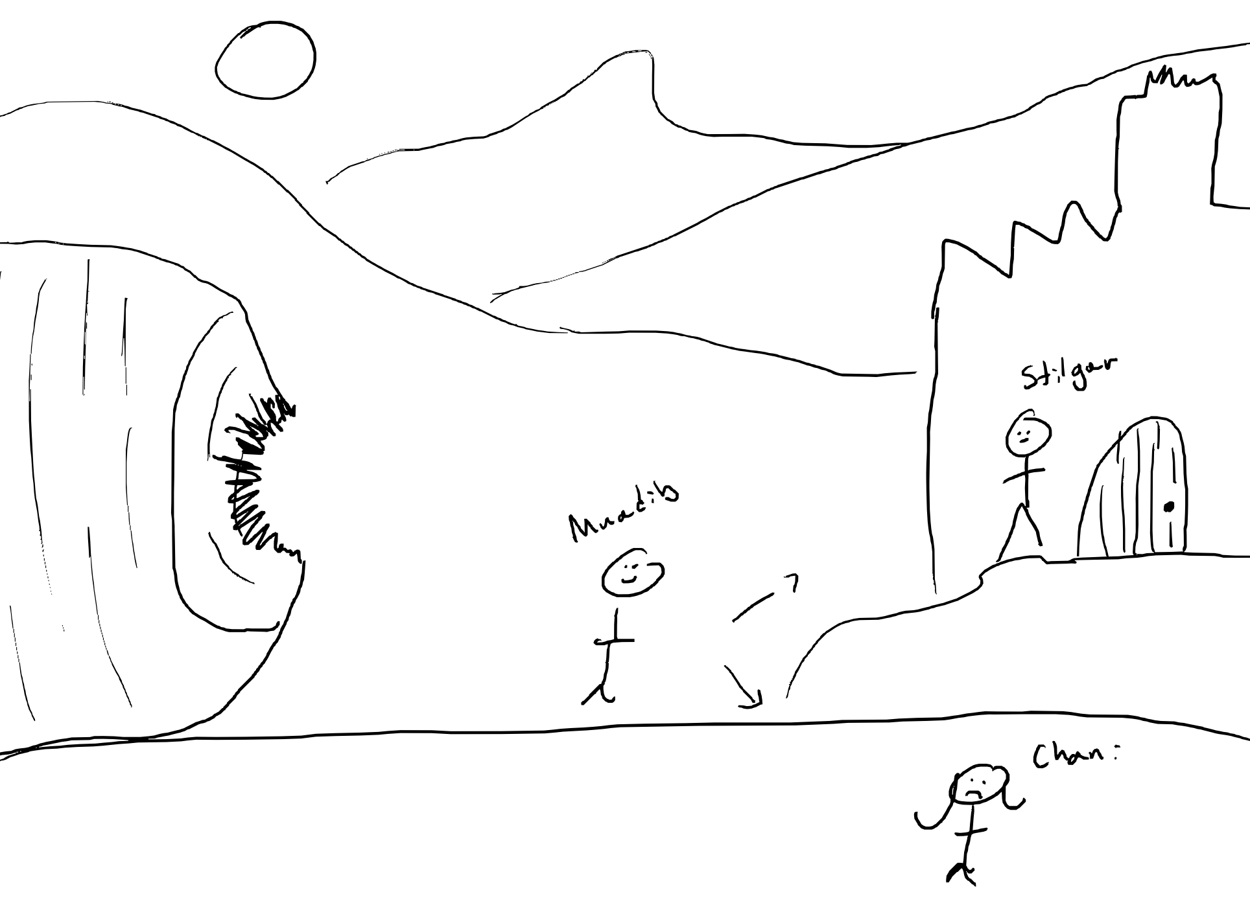
Storyboard: 6
After completing the worm-riding level, Paul is now Maudib and gets off the worm at the entrance to the palace. Then, he is faced with a choice. He can choose to go with Chani and spend the rest of his life with her, living out the rest of his days in peace. Or he can go with Stilgar to fight Feyd Rautha, which will bring a green paradise to Arrakis and genocide to the rest of the galaxy

Slide 10
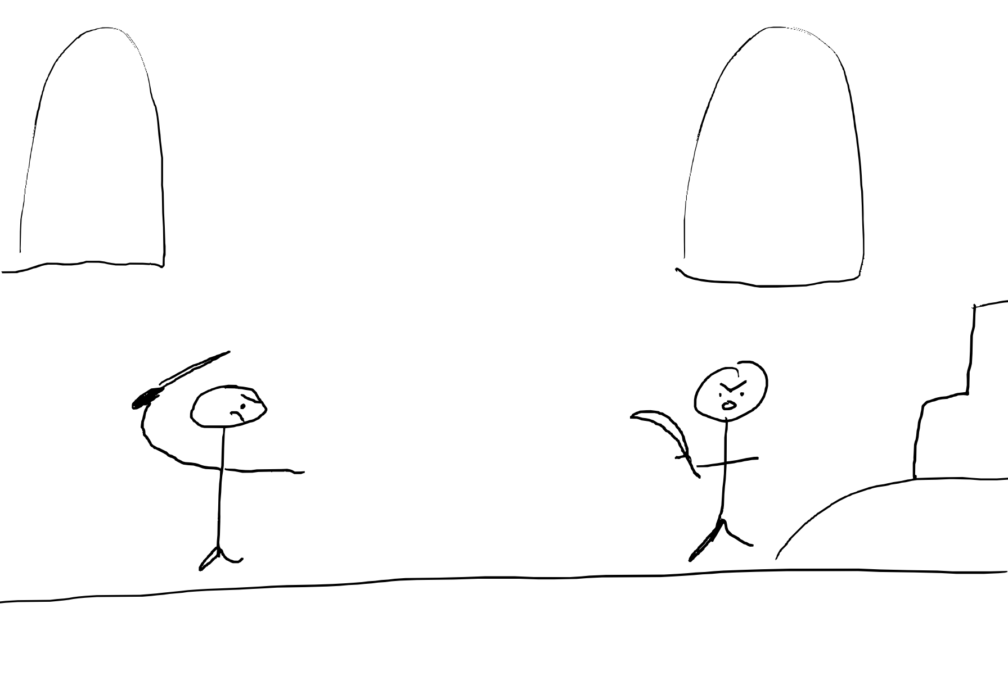
Storyboard: 7
Maudib decided to dual feyd Rautha. He needs to defend himself and attack the Harkonen Scum. If he wins, he will be emperor of the galaxy and bring a green paradise to Arrakis and genocide to the rest of the galaxy. If he looses he will die.

Slide 11
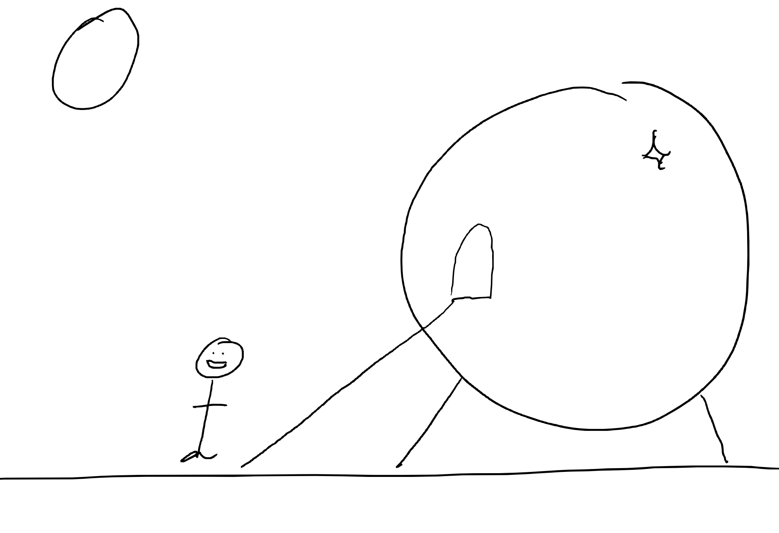
Storyboard: 8
This is a cutscene that signifies the end of the game. After winning the fight against Feyd Rautha, Paul enters a spaceship and begins his conquest.

Slide 12
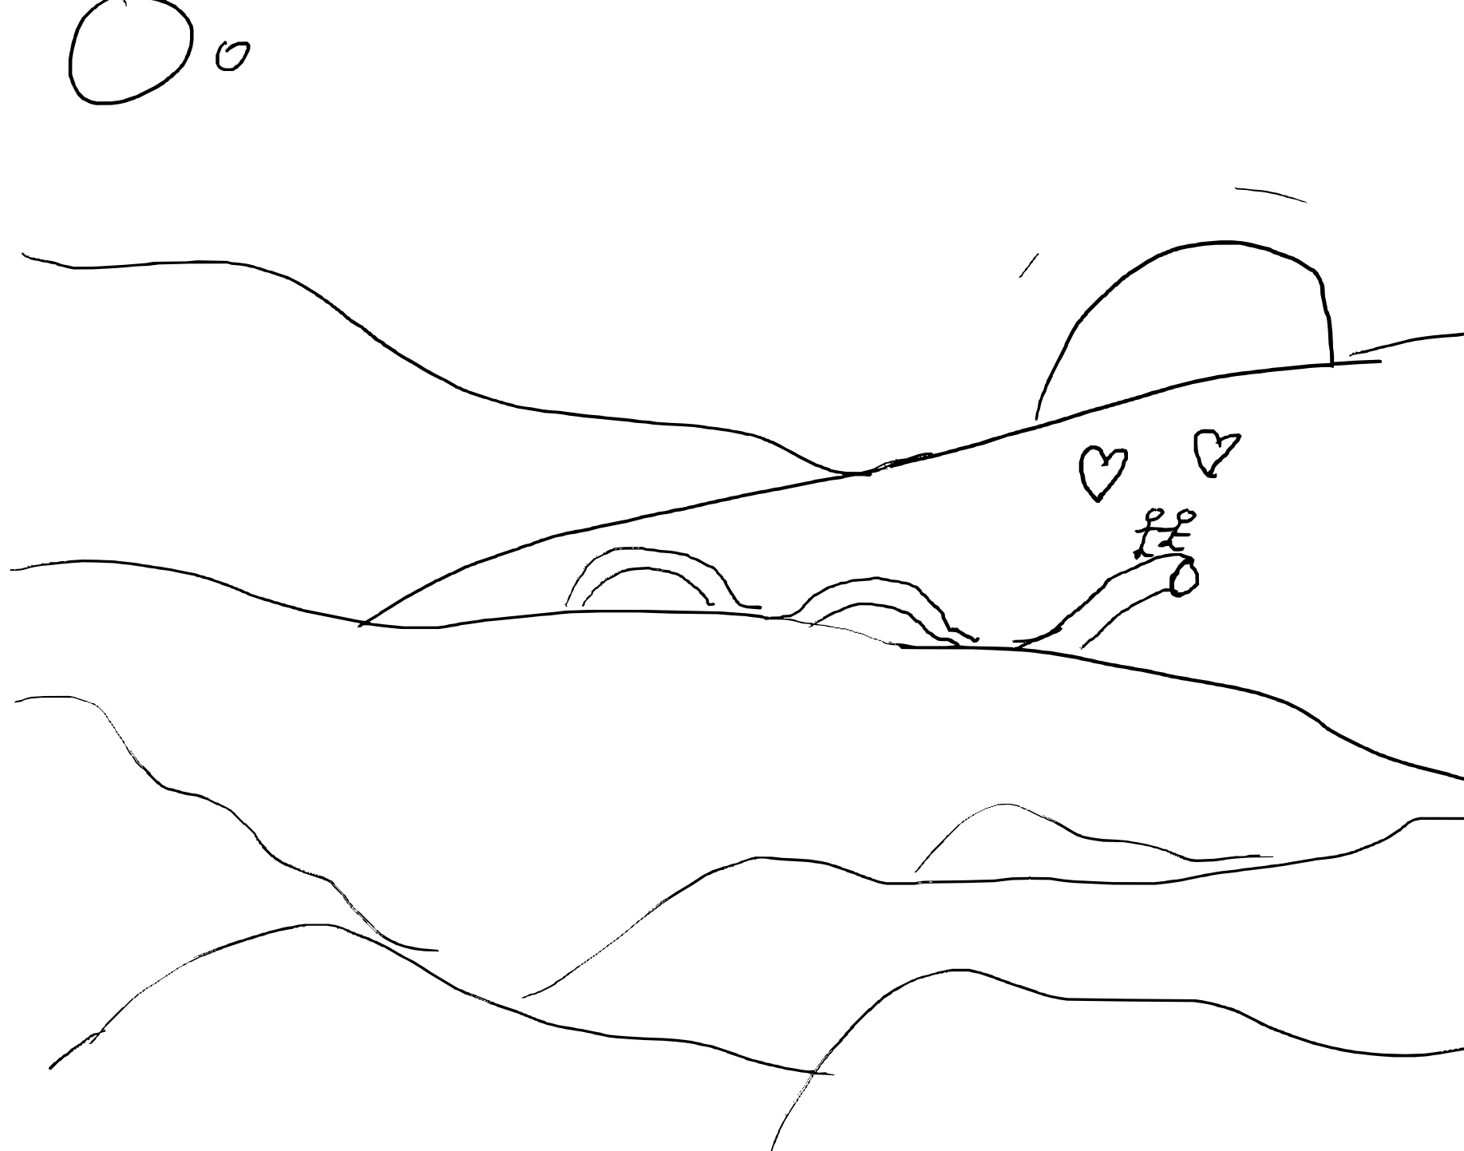
Storyboard: Leave with Chani Ending
If Paul decides to leave with Chani and not continue today his journey to defeat Feyd-Rauth, he can instead take the worm and ride off into the future together. This ends the game with Chani.

Slide 13
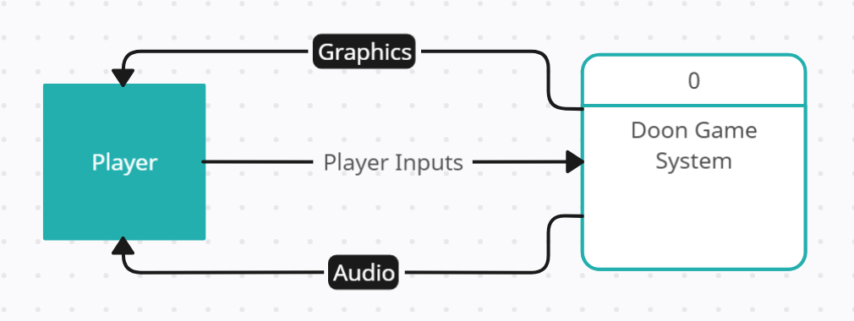
Context Diagram

Slide 14
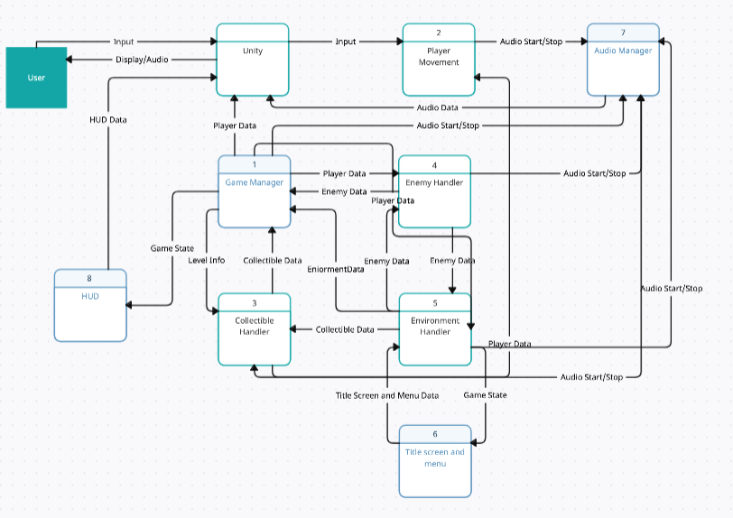
Diagram 0
Responsibilities:
Amara
Collectible Handler
Andreas
HUD
Game Manager
Caden
Enemy Handler
Elizabeth
Player Movement
Joe
Menus
Audio Manager
Other
Environment Handler

Slide 15
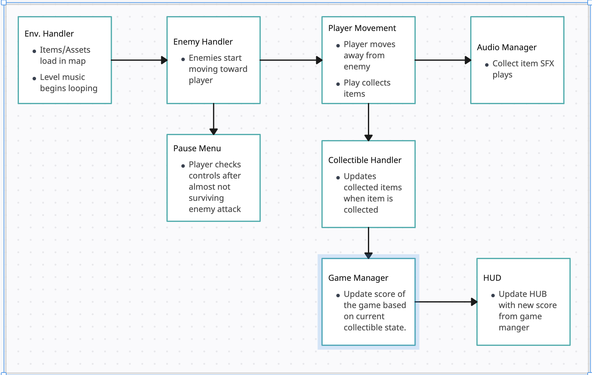
Global Use Case: Find Stil Suit Items

Slide 16
Joseph Baruch
TL3: QA Manager
Features:
Audio Manager
Title Screen / Pause menu

Slide 17
Audio Manager
Role in overall project
Feedback to user on their actions.
Adds to experience and help immerse into Arrakis.
Priority: Low (3)
Not needed to play or enjoy game.
Adds to experience but not required.
Work Complexity: High (1)
Need to handle unfamiliar data (audio assets).
Streamline integration: Tie into almost all actions in the game efficiently.
Vocals are pitched high so I might lose my voice when recording.

Slide 18
Title Screen / Pause Menu
Role in overall project
Starting/Stopping/Pausing Game.
Adds to experience of game: Ease the user in and out of the game.
Priority: Medium
Poor user experience if there is no menus.
Could still play the game without them.
Work Complexity: Low
Similar to requirements in the Pong.
How: Simply change scene from title screen to main game. Return if necessary.

Slide 19
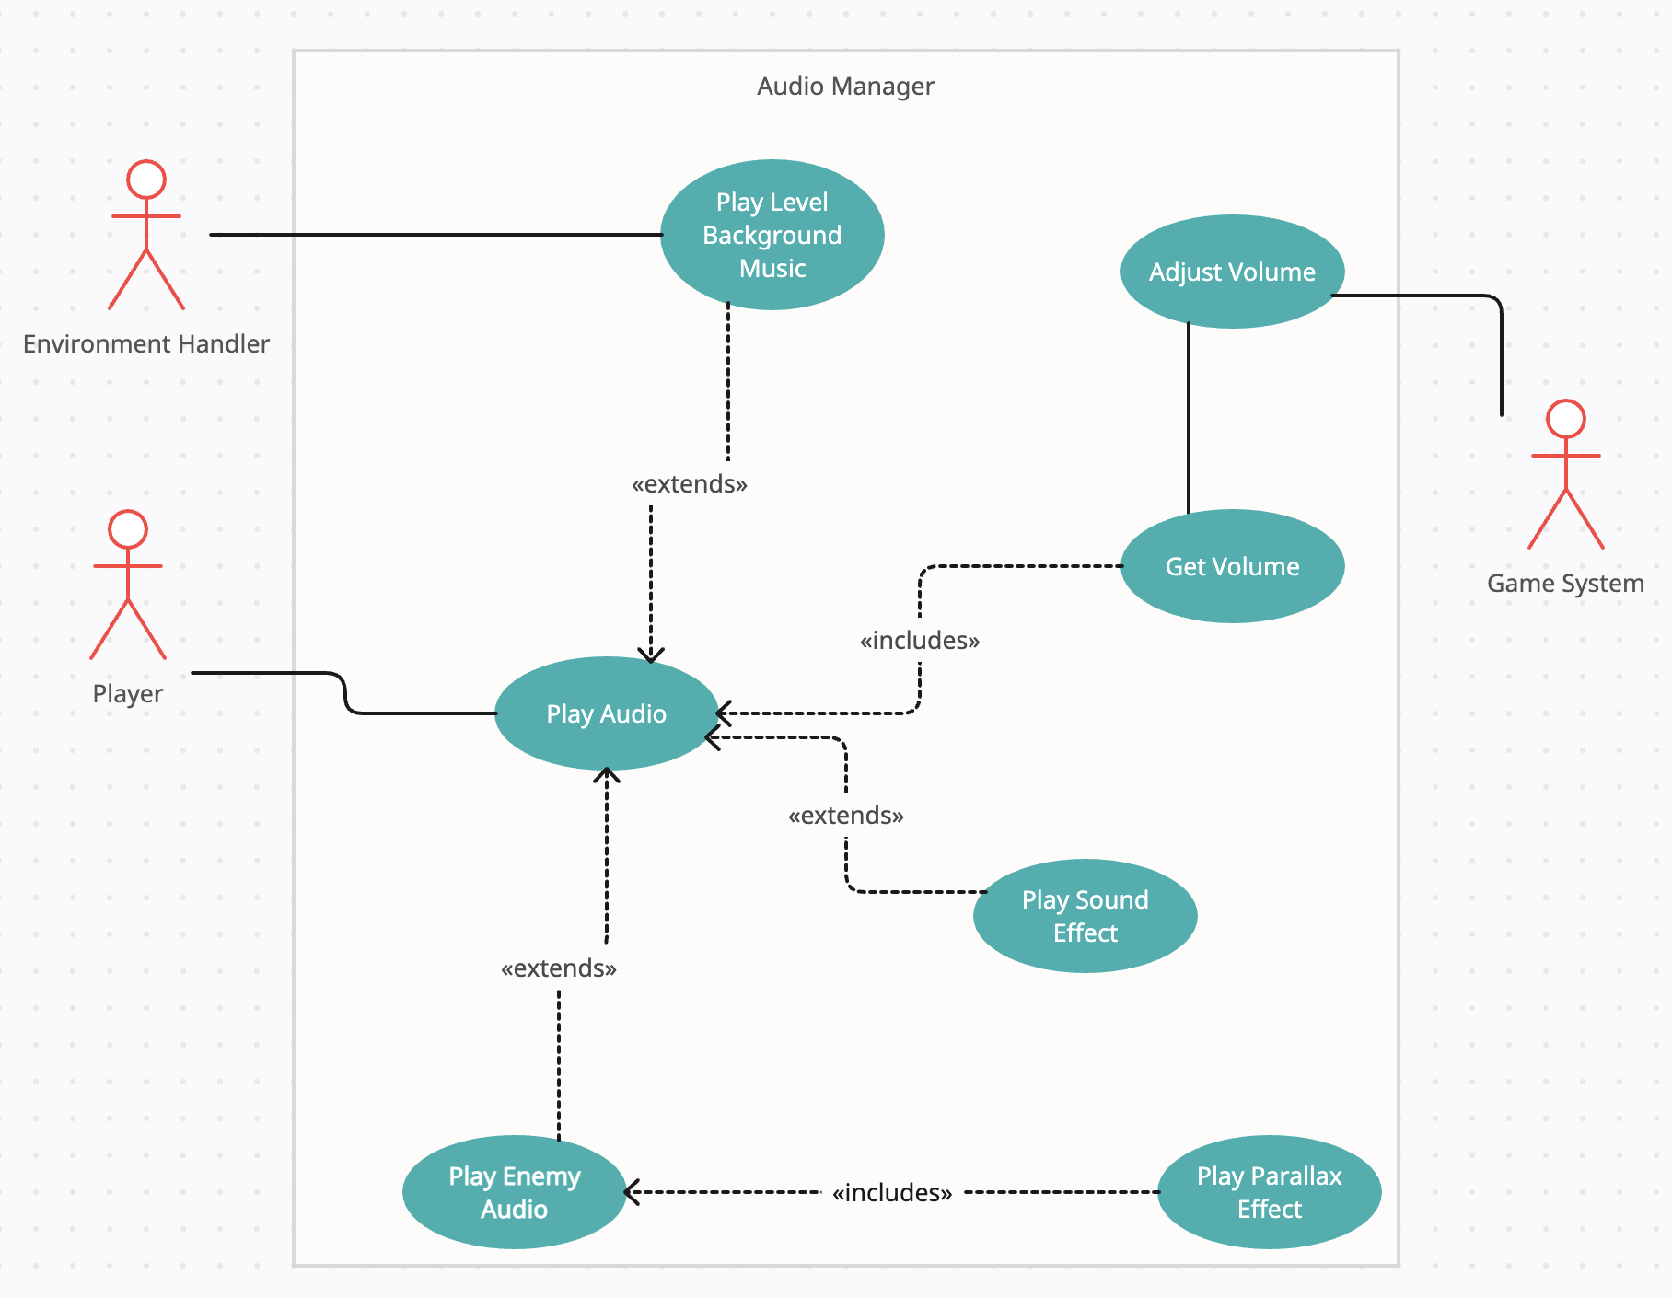
Use Case Diagram: Audio Manager

Slide 20
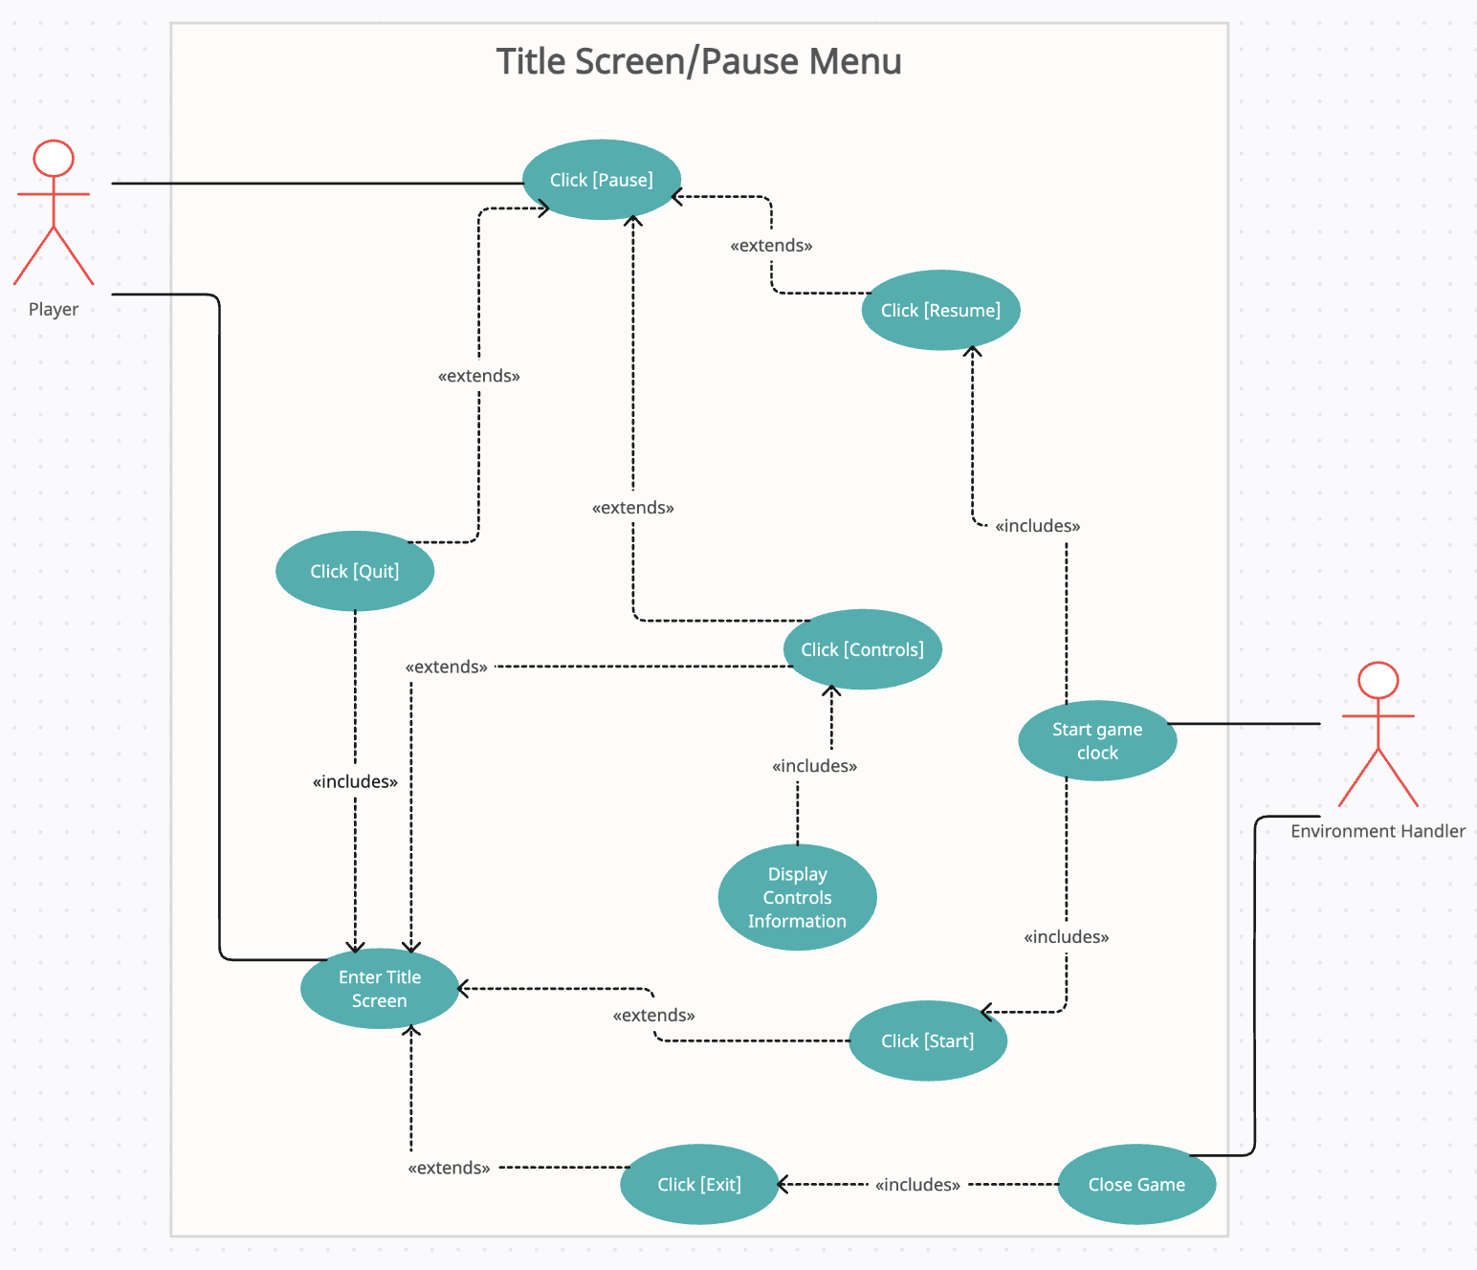
Use Case Diagram: Title Screen / Pause Menu

Slide 21
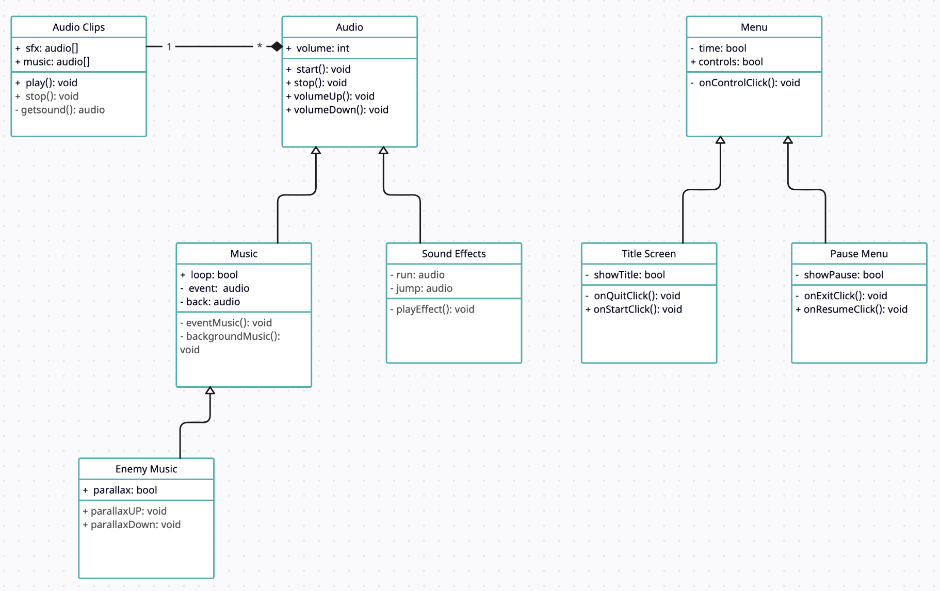
Class Diagram

Slide 22
Elizabeth Smith
TL6: Version Control Manager
Feature: Player and Controls

Slide 23
Player Controls
Role
Create Playable Character
Implement controls for different levels and devices
Priority: High (1)
User needs some sort of playable character and controls to progress through the game.
Complexity: Medium (2)
Hardest parts will be Level 2 mobile controls

Slide 24
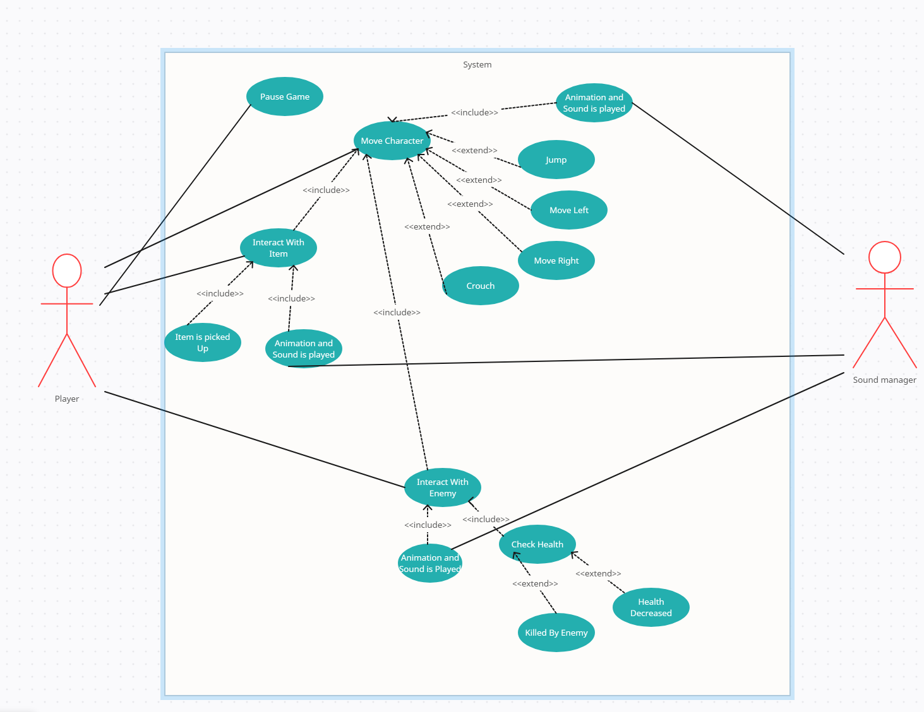
Use Case

Slide 25
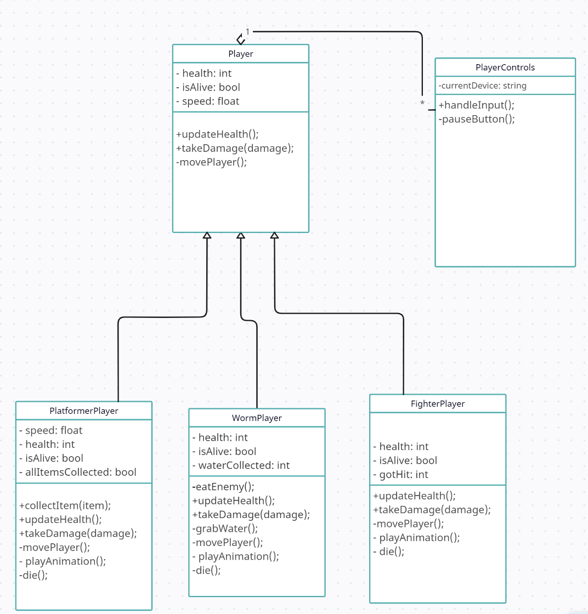
Class Diagram

Slide 26
Caden Sampsel
Team Lead 5: AI Specialist
Features: Enemy AI

Slide 27
Enemy AI
Role in overall project​
Track and chase around the player.
Adds a challenge/obstacle to the game.
Priority: Medium​ (2)
The game doesn't need enemies to run.
Makes the game much more fun/engaging to play.
Work Complexity: Medium (2)
Could be hard to make enemies path around different obstacles.
Different levels have different enemy types/pathing.

Slide 28
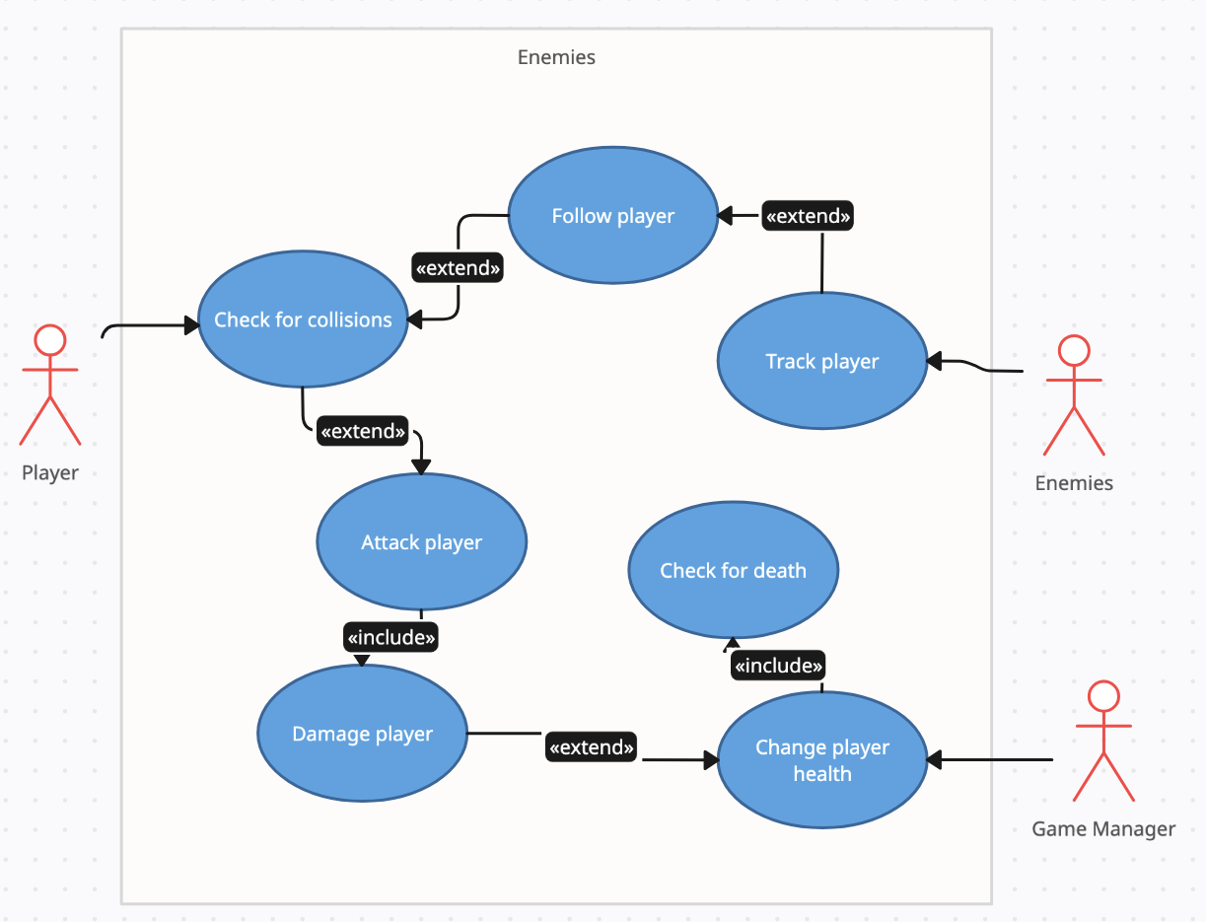
Use Case

Slide 29
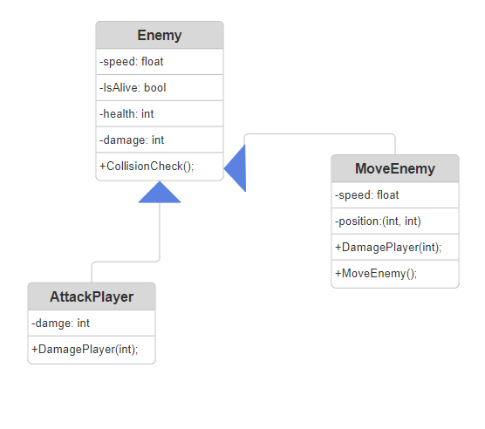
Class Diagram

Slide 30
Andreas Neacsu
Team Lead 2: Software Architect
Responsible for:
Game Manager
HUD

Slide 31
Game Manager
Role in overall project:
Facilitates data exchange between environment handler, collectibles handler, and enemy handler by providing a centralized location for global data to be stored and accessed
Priority: High (1)
Required in order for several other components to function properly
Work Complexity: Medium (2)
The game manager will be responsible for level transitions, managing NPCs, objectives, collectibles inventory, and player / enemy health.

Slide 32
HUD
Role in Project:
Display essential information to the player such as, health, collectibles, boss health, current objective and current level progress
Priority: Medium
Nice to have but not essential for core functionality of the game
Work Complexity: Easy
Creating a GUI and the corresponding assets.

Slide 33
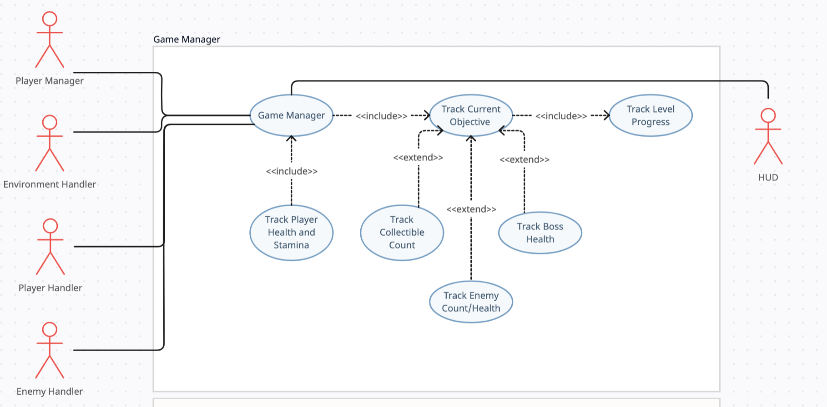
Use Case Diagram (Game Manager)

Slide 34
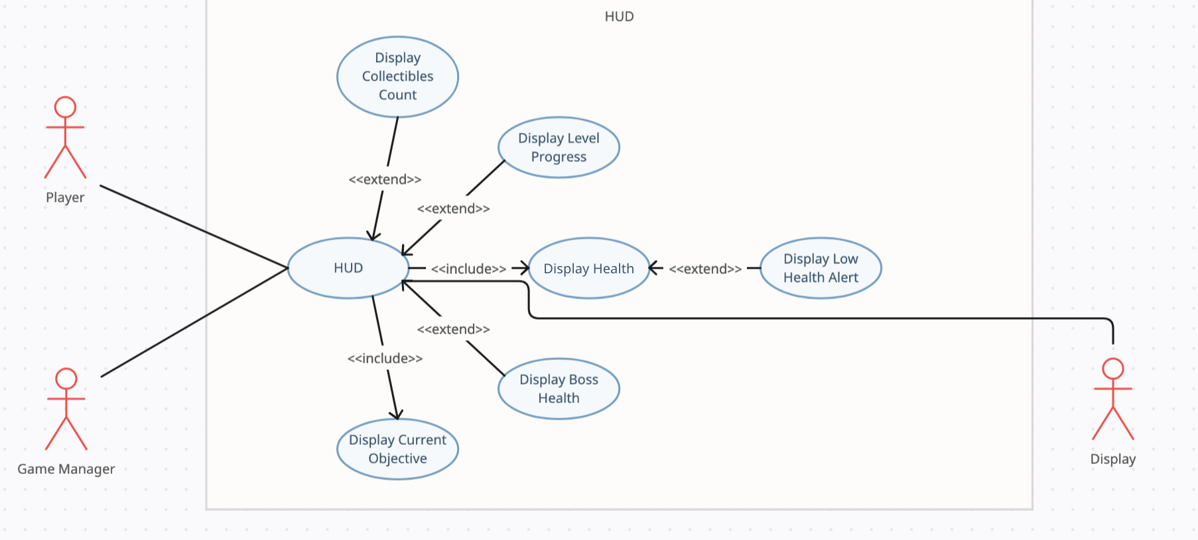
Use Case Diagram (HUD)

Slide 35
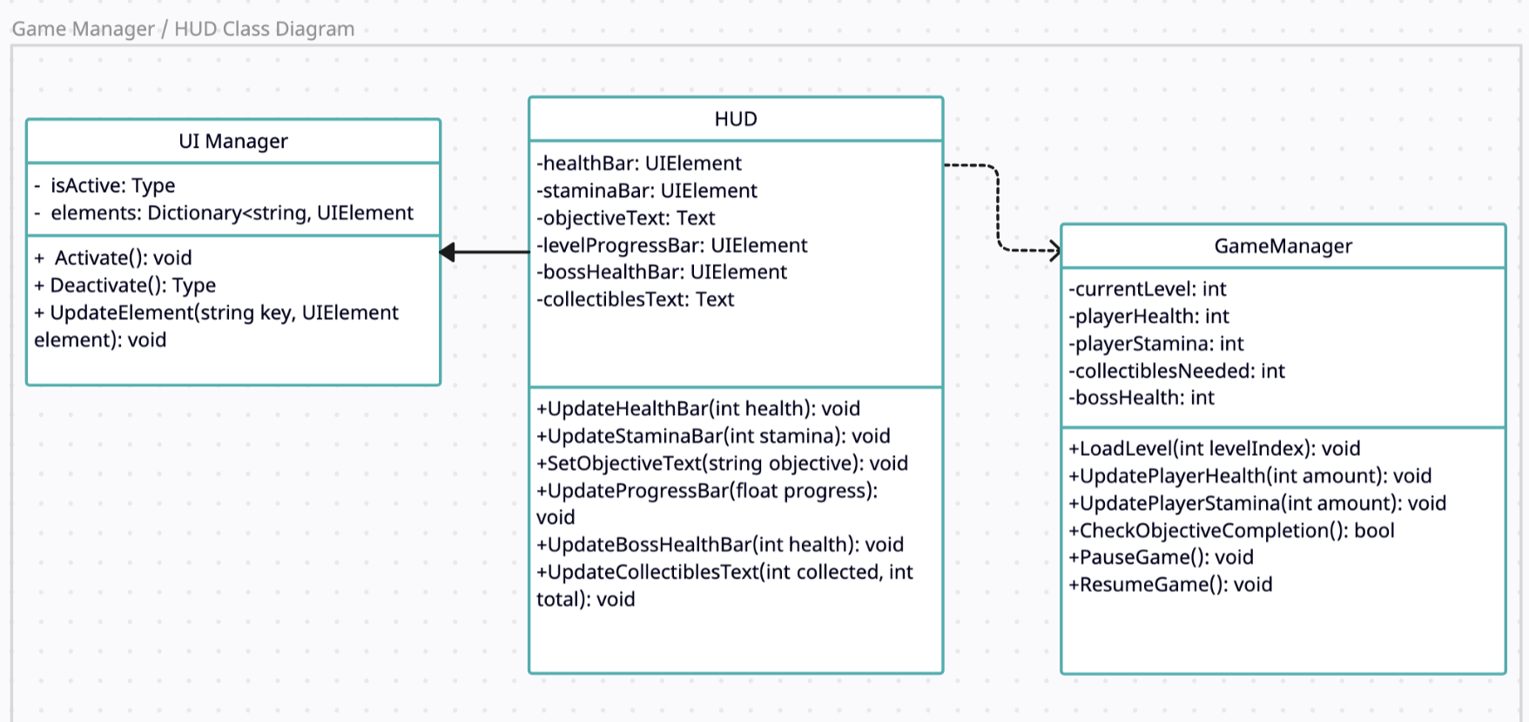
Class Diagram

Slide 36
Amara Jeide
Team Lead 4: Project Manager
Responsibilities
Collectible Handler

Slide 37
Collectible Handler
Roll in overall project
Creating and managing all collectible items in game
Priority: Medium (2)
The game will technically run without them
Needed for fun/engaging gameplay
Work complexity: Low (3)
Creating items is less complex
Properly getting items to mesh with other components of the game is more challenging

Slide 38
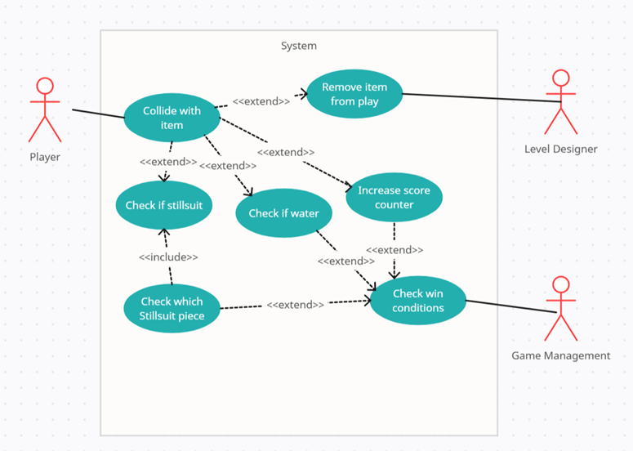
Use Case

Slide 39
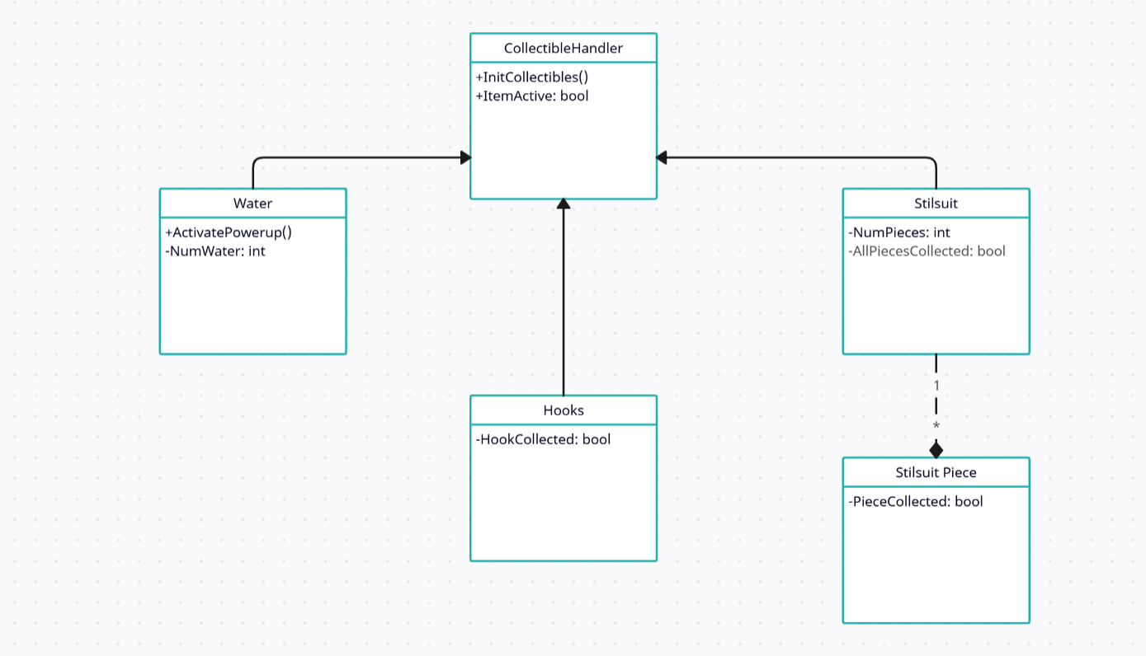
Class Diagram

Slide 40
End of Presentation: Questions?

